Slide 1
CS35L-5
Week 8 Lec 2

Slide 2
GCC Flags
-fPIC: Compiler directive to output position independent code, a characteristic required by shared libraries.
-lXXX: Link with "libXXX.so”
Without -L to directly specify the path, /usr/lib is used.
-Ldir: At compile time, find library from this path.
-Wl,rpath=.: -Wl passes options to linker. -rpath at runtime finds .so from this path.
-c: Generate object code from c code.
-shared: Produce a shared object which can then be linked with other objects to form an executable.
https://gcc.gnu.org/onlinedocs/gcc/Link-Options.html#Link-Options

Slide 3
Creating static and shared libs in GCC
●
mymath.h
●
mul5.c
●
add1.c
#ifndef MY_MATH_H
#include "mymath.h"
#include "mymath.h"
#define MY_MATH_H
void mul5(int *i)
void add1(int *i)
void mul5(int *i);
{
{
void add1(int *i);
*i *= 5;
*i += 1;
#endif
}
}
gcc -c mul5.c -o mul5.o gcc -c add1.c -o add1.o
ar -cvq libmymath.a mul5.o add1.o ----> (static lib)
gcc -shared -fpic -o libmymath.so mul5.o add1.o -----> (shared lib)
●
●
●
●

Slide 4
Dynamic loading
#include <stdio.h>
#include <dlfcn.h>
int main(int argc, char* argv[]) {
int i = 10;
void (*myfunc)(int *); void *dl_handle;
char *error;
dl_handle = dlopen("libmymath.so", RTLD_LAZY);//RTLD_NOW
if(!dl_handle) {
printf("dlopen() error - %s\n", dlerror()); return 1;
}
//Calling mul5(&i);
myfunc = dlsym(dl_handle, "mul5"); error = dlerror();
if(error != NULL) {
printf("dlsym mul5 error - %s\n", error); return 1;
}
myfunc(&i);
//Calling add1(&i);
myfunc = dlsym(dl_handle, "add1"); error = dlerror();
if(error != NULL) {
printf("dlsym add1 error - %s\n", error); return 1;
}
myfunc(&i);
printf("i = %d\n", i);
dlclose(dl_handle);
return 0;
}
Copy the code into main.c gcc main.c -o main -ldl
You will have to set the environment variable LD_LIBRARY_PATH to
include the path that contains libmymath.so
●
●
●

Slide 5
Attributes of Functions
Used to declare certain things about functions called in your program
Help the compiler optimize calls and check code
Also used to control memory placement, code generation options or call/return conventions within the function being annotated
Introduced by the attribute keyword on a declaration, followed by an attribute specification inside double parentheses

Slide 6
Attributes of Functions
__attribute__ ((__constructor__))
Is run when dlopen() is called
__attribute__ ((__destructor__))
Is run when dlclose() is called
Example:
__attribute__ ((__constructor__))
void to_run_before (void) {
printf("pre_func\n");
}

Slide 7
Homework 8
Split randall.c into 4 separate files
Stitch the files together via static and dynamic linking to create the program
randmain.c must use dynamic loading, dynamic linking to link up with randlibhw.c and randlibsw.c (using randlib.h)
Write the randmain.mk makefile to do the linking

Slide 8
Homework 8
randall.c outputs N random bytes of data
Look at the code and understand it
Helper functions that check if hardware random number generator is available, and if it is, generates number
Hw RNG exists if RDRAND instruction exists
Uses cpuid to check whether CPU supports RDRAND (30th bit of ECX register is set)
Helper functions to generate random numbers using software implementation (/dev/urandom)
main function
Checks number of arguments (name of program, N)
Converts N to long integer, prints error message otherwise
Uses helper functions to generate random number using hw/sw

Slide 9
Homework 8
Divide randall.c into dynamically linked modules and a main program
Don’t want resulting executable to load code that it doesn't need (dynamic loading)
randcpuid.c: contains code that determines whether the current CPU has the RDRAND instruction. Should include randcpuid.h and include interface described by it.
randlibhw.c: contains the hardware implementation of the random number generator. Should include randlib.h and implement the interface described by it.
randlibsw.c: contains the software implementation of the random number generator. Should include randlib.h and implement the interface described by it.
randmain.c: contains the main program that glues together everything else. Should include randcpuid.h (as the corresponding module should be linked statically) but not randlib.h (as the corresponding module should be linked after main starts up). Depending on whether the hardware supports the RDRAND instruction, this main program should dynamically load the hardware-oriented or software-oriented implementation of randlib.

Slide 10
Change Management

Slide 11
Software development process
●
Involves making a lot of changes to code
New features added Bugs fixed
Performance enhancements
–
–
–
●
Software team has many people working on the same/different parts of code
Many versions of software released
●
–
Ubuntu 10, Ubuntu 12, etc
Need to be able to fix bugs for Ubuntu 10 for customers using it, even though you have shipped Ubuntu 12.
–

Slide 12
Source/Version Control
●
Track changes to code and other files related to the software
–
What new files were added? What changes made to files?
Which version had what changes? Which user made the changes?
–
–
–
●
Track entire history of the software Version control software
●
–
GIT, Subversion, Perforce

Slide 13
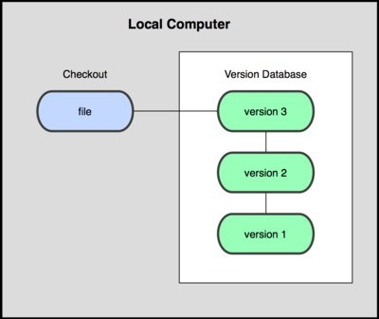
Local VCS
●
Organize different versions as folders on the local machine
No server involved
Other users should copy it via disk/network
●
●
Image Source: git-scm.com

Slide 14
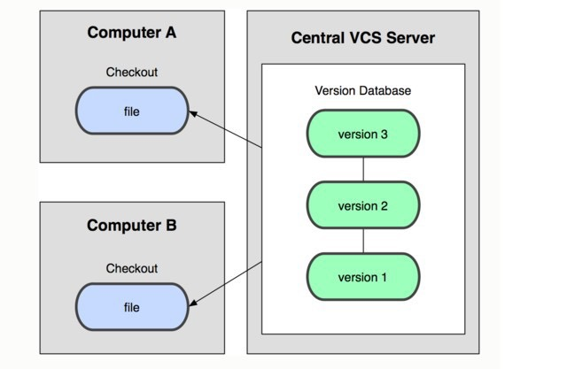
Centralized VCS
●
Version history sits on a central server
Users will get a working copy of the files
Changes have to be committed to the server
All users can get the changes
●
●
●
Image Source: git-scm.com

Slide 15
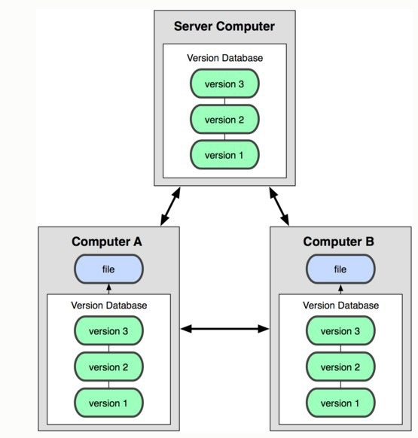
Distributed VCS
Version history is replicated at every user's machine
Users have version control all the time
Changes can be communicated between users
Git is distributed
●
●
●
●
Image Source: git-scm.com

Slide 16
Terms used
●
Repository
–
Files and folder related to the software code Full History of the software
–
●
Working copy
–
Copy of software's files in the repository
●
Check-out
–
To create a working copy of the repository
●
Check-in / Commit
–
Write the changes made in the working copy to the repository
Commits are recorded by the VCS
–

Slide 17
